Slide 1

Hands-on workshop on developing Reinforcement Learning solutions with financial domain domain example use cases.

Slide 2
Who am I
Ade Idowu
Lead Data Scientist @ UBS
Experience: Over 15 years working as a software/ML engineer
Email: adeidowu@hotmail.com
Github: https://github.com/aidowu1
LinkedIn: https://www.linkedin.com/in/ade-idowu-ph-d-854b88/

Slide 3
Agenda
Structure of the workshop
A brief intro to Reinforcement Learning
A close look at model-free RL models
An overview some popular of RL frameworks
Applications of RL in Finance
Future work & conclusions
Demos
Q & A

Slide 4
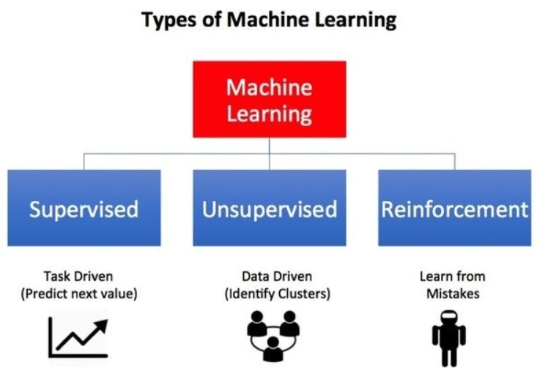
Taxonomy of Machine Learning
Chirag Karia, "Categories of Machine Learning" Kychdev, 2020

Slide 5
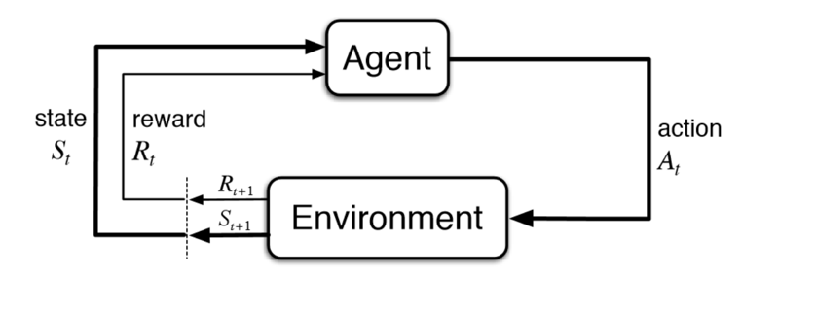
What is Reinforcement Learning
1. Sutton, R. S., & Barto, A. G. (2018). “Reinforcement Learning: An Introduction”. MIT Press.

Slide 6
Markov Decision Process
S: a set of states
A: a set of actions
P: transition probability
R: Reward function
𝞬: Discount factor for future rewards

Slide 7
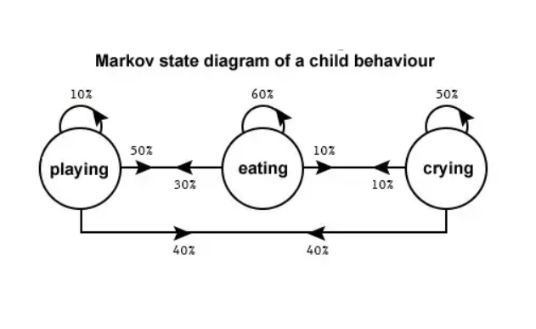
Making sequential decisions in an uncertain environment
“Next state and reward only depend on the current state and action taken”
Suraj Bansal, "Markov Decision Processes — Learning Some Math", Medium 2020

Slide 8
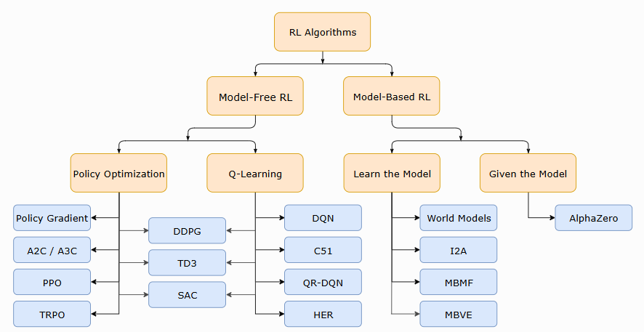
Taxonomy of Reinforcement Learning
Courtesy of OpenAI Spinning Up

Slide 9
Model-based vs Model-free RL
Model-based:
Model tries to understand the environment dynamics
Model typically will have well defined transition probabilities
If problem domain action/state space is small it can be solved using Dynamic Programming

Slide 10
Model-based vs Model-free RL
Model-free:
Maximizes the expected reward without a model or prior knowledge
Normally used when we have incomplete info about environment or model
The agent’s policy provides insight on the optimal action to take in a certain state to maximize the rewards
Each state is associated with a value function V(s) or action-value function Q(s, a)
V(s) and Q(s,a) quantifies how good a state is
Model-free can either be value-based or policy-based

Slide 11
Value-based RL - Q-learning
Q - learning:
Q-learning is the adaptation of Temporal Difference (TD) learning
This algorithm computes which action to take based on V(s) or Q (s,a)
Q-learning is an off-policy approach meaning is does not need to select actions based on the policy implied by the value function alone
To encourage a balance between exploration and exploitation, an epsilon-greedy strategy is used to select a random action with probability 𝛆, else action is selected based on max Q(s,a)

Slide 12
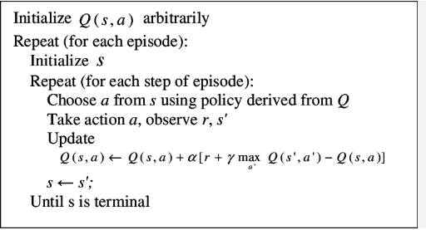
Value-based RL - Q-learning
Q - learning algorithm steps:
1. Sutton, R. S., & Barto, A. G. (2018). “Reinforcement Learning: An Introduction”. MIT Press.

Slide 13
Value-based RL - SARSA
Q - learning:
SARSA is also based on Temporal Difference (TD) learning
It updates Q(s,a) by the sequence of S_{t}, A_{t}, R_{t+1}, S_{t+1}, A_{t+1}
SARSA is an on-policy approach meaning it finds the optimal policy and uses it to invoke an action
Unlike Q-learning, SARSA policies used for updating and for acting are the same

Slide 14
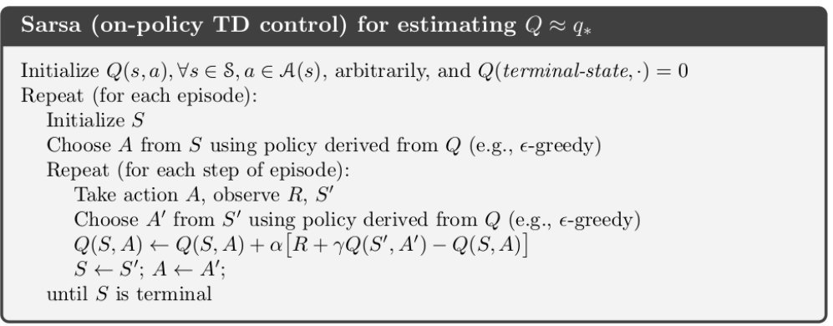
Value-based RL - SARSA
SARSA algorithm steps are:
1. Sutton, R. S., & Barto, A. G. (2018). “Reinforcement Learning: An Introduction”. MIT Press.

Slide 15
Deep RL DRL
Deep Reinforcement Learning is a sub-field of ML that combines deep learning with RL
As the dimensionality of action and state space for problems increase it becomes very ineffective and inefficient to use traditional Q-learning and SARA approaches
DRL uses deep neural networks to represent policies, value-functions or environment to solve RL problems at scale
Some popular DRL algorithms are Deep Q Network (DQN), Deep Deterministic Policy Gradient (DDPG), Proximal Policy Gradient (PPO), Soft Actor-Critic (SAC) etc..

Slide 16
Value-based RL - DQN
DQN is the DRL extension of Q-learning (Mnih et al, 2013)
It uses neural network to approximate the calculation of Q-values by learning a set of weights θ of the deep neural network which maps states to actions
It uses experience replay, which involves storing the history of state, action, reward and next state transitions in a large replay data structure.
Experience replay improves data efficiency and remove correlations in observation sequences
DQN also uses a target network, which is used for periodic updating of the network weights via the minimization of the loss using gradient descent

Slide 17
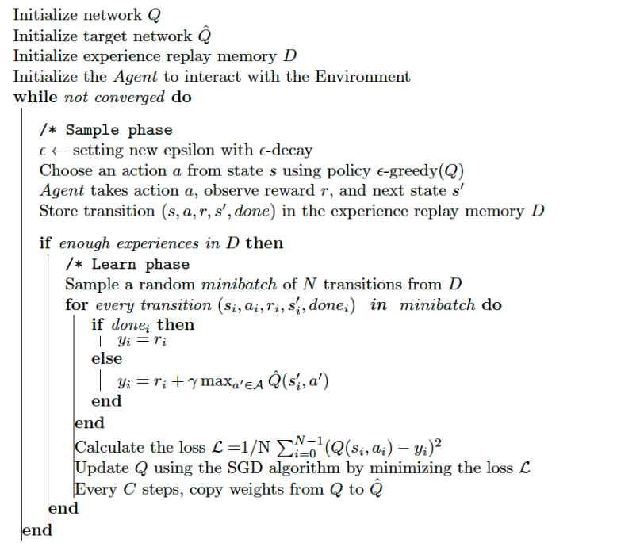
Value-based RL - DQN
DQN algorithm steps:
Jordi TORRES.AI, "Deep Q-Network (DQN)-II", Towards Data Science, 2020

Slide 18
Policy-based RL
Policy-based RL typical involves learning the policy function, 𝝅 which maps each state to the best corresponding action
Policy based can occasionally be simpler than value-based methods
Most policy based techniques include DRL algorithms such as DDPG, Twin Delayed DDPG (TD3), PPO etc.

Slide 19
DDPG - policy/value-based RL
DDPG is a robust algorithm for solving RL problems in continuous action spaces (Lillicrap et al., 2015)
It combines the strengths of policy gradient methods and Q-learning, enabling effective policy optimization for complex control tasks in high-dimensional environments.
It is a hybrid value and policy based algorithm
It uses an actor-critic architecture, where the actor learns a deterministic policy, and the critic evaluates the policy using a Q-value function

Slide 20
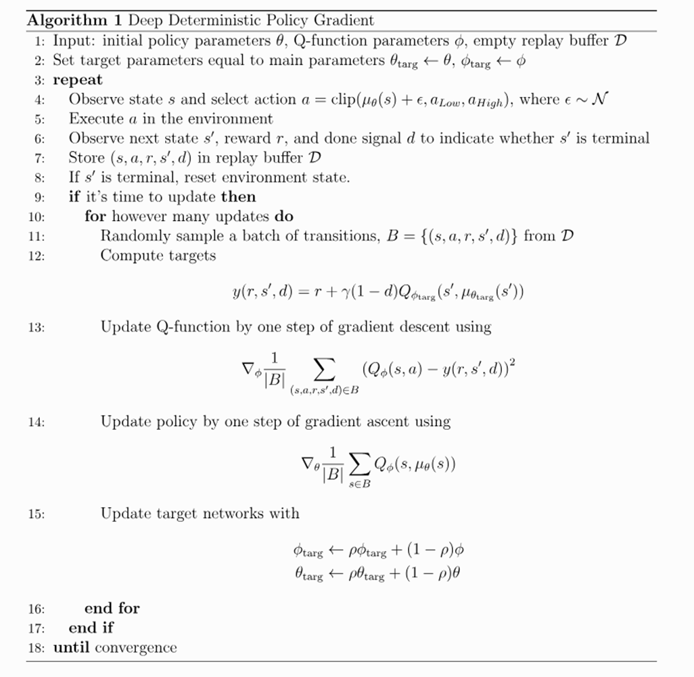
DDPG - policy/value-based RL
DQN algorithm steps are:
Achiam, J. (2018). Spinning Up in Deep Reinforcement Learning. OpenAI

Slide 21
PPO - Policy-based RL
PPO algorithm is a policy-based technique introduced by Schulman et al. (2017)
PPO is designed to enhance the training stability and computational efficiency
PPO can be used for environments with either discrete or continuous action spaces.
In some open source RL libraries like Stable-baselines, Machin etc, PPO can be parallelized

Slide 22
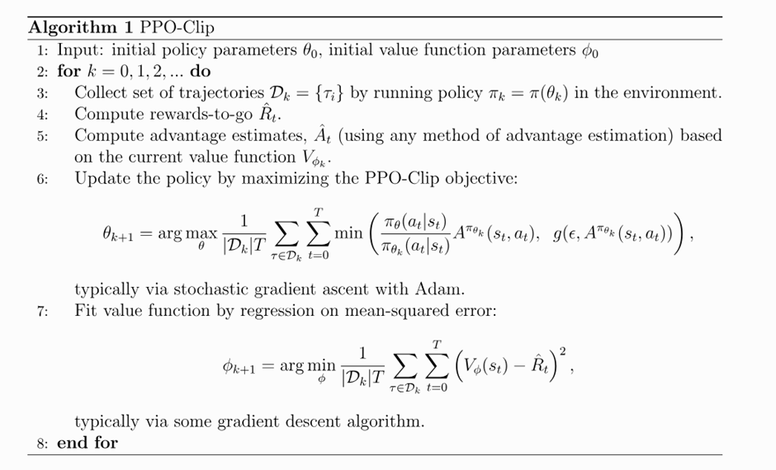
PPO - Policy-based RL
PPO algorithm steps:
Achiam, J. (2018). Spinning Up in Reinforcement Learning - PPO. OpenAI

Slide 23
SAC - policy/value-based RL
SAC is an off-policy algorithm developed by Haarnoja et al, (2018)
It can theoretically be used for both discrete and continuous action space problems.
In the Demo I used it to solve the Gymnasium Pendulum continuous action space problem
SAC addresses these issues by maximizing both the expected reward and the entropy of the policy
The entropy term incentivises stochasticity in action selection, ensuring that the policy remains exploratory throughout training

Slide 24
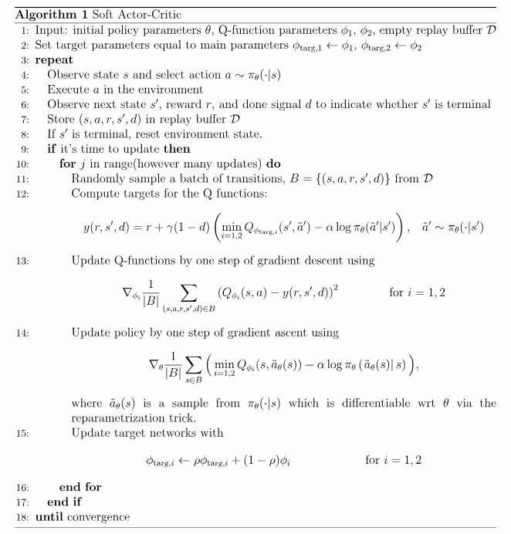
SAC - policy/value-based RL
SAC algorithm steps:
Achiam, J. (2018). Spinning Up in Deep Reinforcement learning - SAC OpenAI

Slide 25
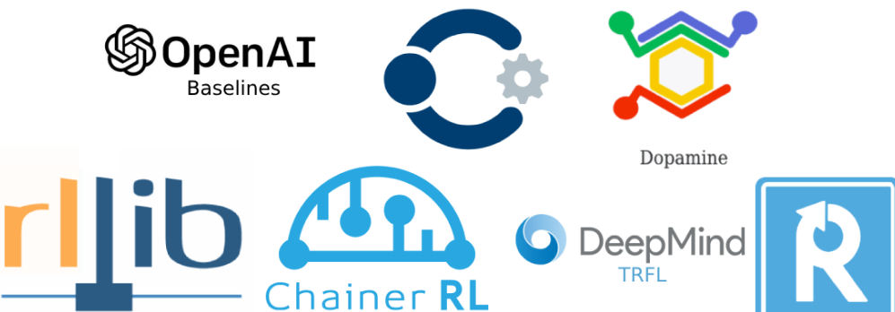
Review of some RL libraries

Slide 26
Review of some RL libraries
Neptune.AI criteria for selecting these libraries include:
Number of SOTA algorithms implemented
Documentation and availability of tutorials
Code readability
Number of supported environments
Logging and tracking
Vectorization and parallelization
Regular updates
10 top libraries in descending order are: KerasRL, PyQlearning, Tensorforce, RL_Coach, TFAgent, Stable Baselines, MushroomRL, RLlib, Dopamine
I regularly use Stable Baselines and Machin (not rated in the top 10, but I like it!!!)

Slide 27

A quick review of Gymnasium
Gymnasium formerly known as Gym (under OpenAI) is a pythonic framework for simulating RL environments
It allows developers to experiment with precreated RL environments or create customized ones
For financial algo robo RL agent I used Gymnasium to develop the custom TradingEnv environment
Basic steps for creating a custom environment include:
Create your new environment by deriving from the base Env class
Implement a number of key RL methods:
step()
reset()
render()
close

Slide 28
Applications of RL in Finance
RL and DRL is increasingly being used in financial domain uses case such as:
Algorithmic trading of financial instruments:
I will provide a simple demo of this use case but others include the works of Yves Hilpisch (2020)
Hedging risk such as hedging the trading of derivatives/options:
I recently did a project RLDynamicHedger on this, you can find it in this repo also see Cao et al, 2020
Asset allocation and portfolio optimization:
Such as the works of Sato (2019), Charpentier, Elie, and Remlinger (2020) and Mosavi et al. (2020)
Order execution optimization
See for instance the work of Joseph Jerome, et al (2022)

Slide 29
Demos
There will be 5 demos:
The first 2 is an introduction to RL and uses Q-Learning, SARSA and DQN (these were coded natively in python with no RL packages)
The third one is an introduction to continuous action space problems and uses 3rd party open source libraries Machin and Stable Baselines
The fourth demo introduces us to hyper-parameter tuning using Stable Baseline library
The final demo is the main one which demonstrates a simple algo RL agent for trading the S & P index using price/bar data from 2010 to 2019

Slide 30
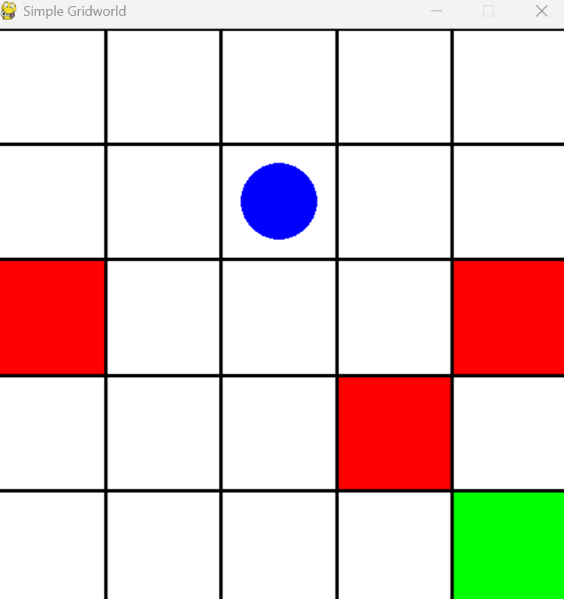
Grid World
This is a classic computer science problem where an agent is trying to find the shortest path to its destination
Action space: Discrete(4)
Observation space: Discrete(25)
Rewards
Red squares are pits: 0 (terminate)
White squares: 0 (continue)
Green square: + 1 (target)

Slide 31
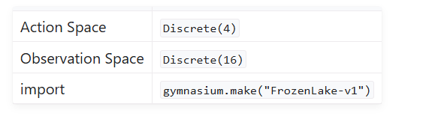
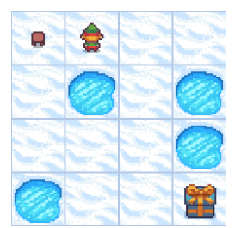
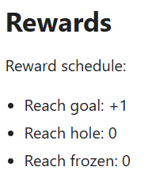
Frozen Lake
Similar to grid world, but this time the agent navigating a frozen lake environment with pot holes

Slide 32
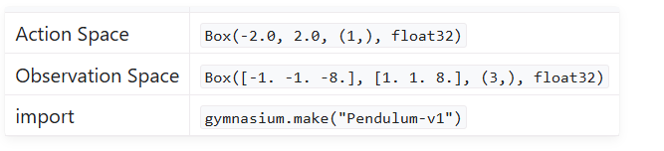
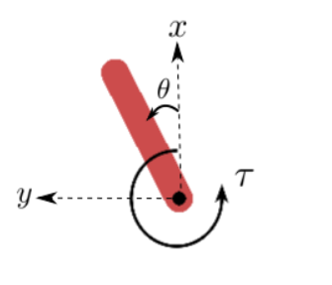

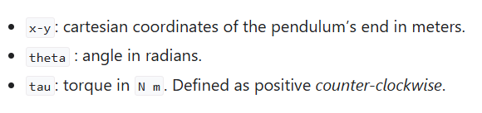
Pendulum
Inverted pendulum swingup problem is based on the classic problem in control theory.
The pendulum starts in a random position and the goal is to apply torque on the free end to swing it into an upright position, with its center of gravity right above the fixed point.

Slide 33
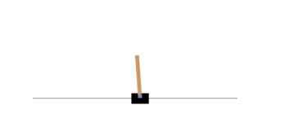
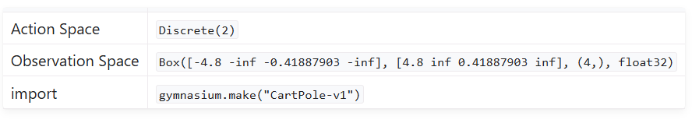
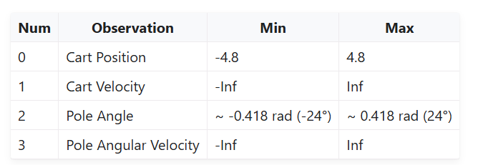

Cart-pole
A pole is attached by an un-actuated joint to a cart, which moves along a frictionless track.
The pendulum is placed upright on the cart and the goal is to balance the pole by applying forces in the left and right direction on the cart.

Slide 34
RL robo algo trader
The RL trading agent can invoke 3 trading actions Hold, Buy or Sell
Profit is only made when it sells a unit of asset in its inventory (from a previous buy)
The bought and sold amount is always a unit of one
There are no transaction costs or robust backtesting considered here or the consideration of risk management management!!
References:
Yves J Hilpisch, "Artificial Intelligence in Finance", page 268 - 276, O'Reilly, 2021
Hariom Tatsat, Sahil Puri & Brad Lookabaugh, "Machine Learning and Data Science Blueprints for Finance", page 298 - 316, O'Reilly, 2021
Mnih, V. et al., "Human-level control through deep reinforcement learning", Nature, 2015.
Moody, J., Saffell, M., "Learning to trade via direct reinforcement", IEEE, 2001.

Slide 35
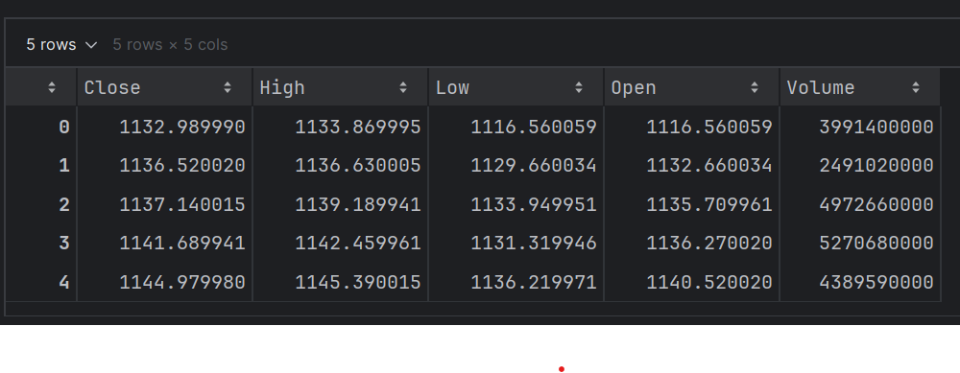
RL robo algo trader
Action space is: Discrete(3)
Observation space is: Box() with shape: (lags, n_features)
Reward is the Profit and Loss

Slide 36
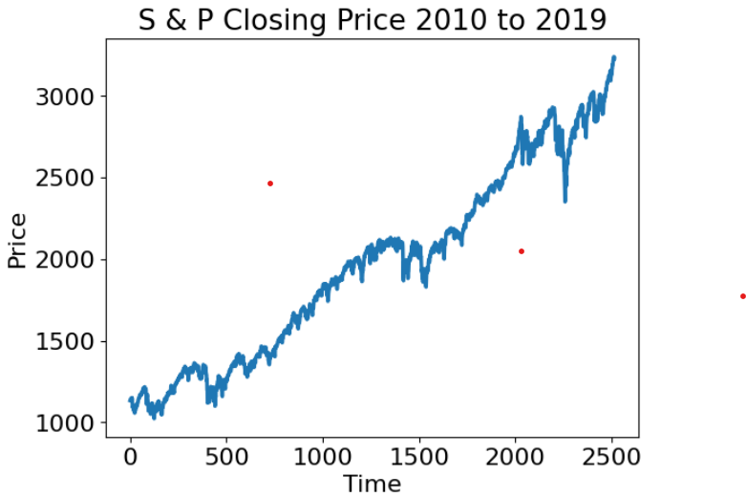
RL robo algo trader - the dataset

Slide 37
RL robo algo trader - Data exploration
The RL data will be partitioned into:
80% training (in-sample) data i.e. 2010-01-04 to 2017-12-26
20% test (out-of-sample) data i.e. 2017-12-27 to 2019-12-31
Feature set will be based on the Close price
Data is scaled using normalization
Close price was transformed into 4 features:
Log normal return
10 window moving average of price
10 window moving average of log-normal return
10-window moving standard deviation of log-normal return
These feature represent the state-space inputs of the RL agent

Slide 38
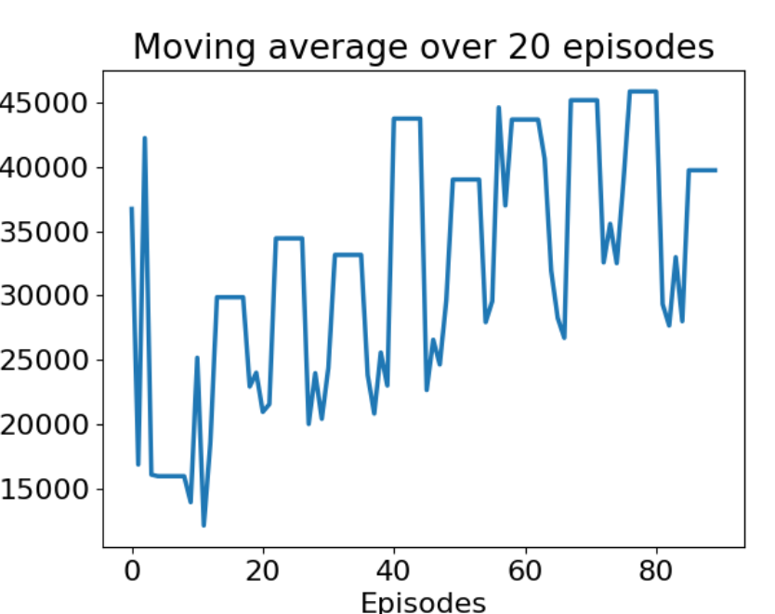
RL robo algo trader - PPO agent Performance

Slide 39
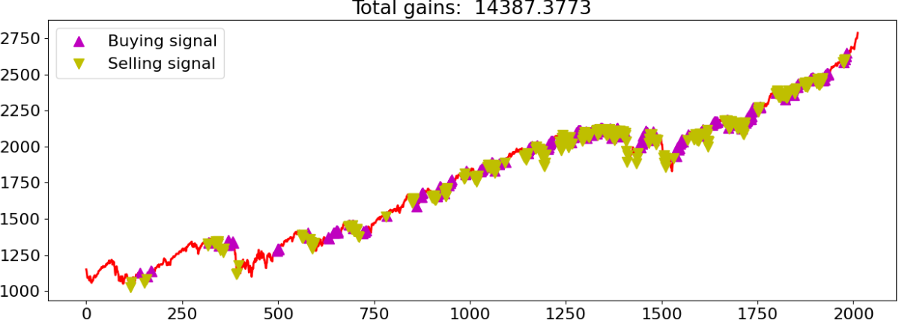
RL robo algo trader - RL training

Slide 40
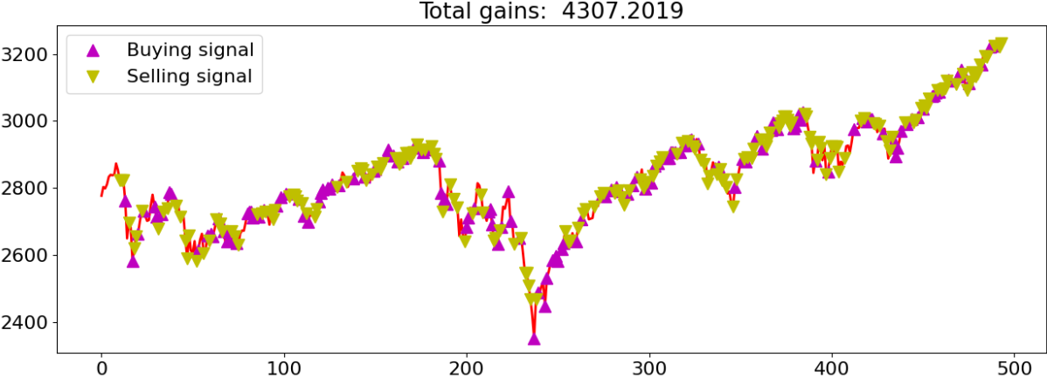
RL robo algo trader - Testing

Slide 41
Conclusions
RL is a robust learning paradigm in finance especially in circumstances where the environment dynamics (market, geo-politics etc) can not be easily modelled
RL allows the trial-and-error exploration/exploitation of the problem domain enabling the model to episodically learn environment dynamics
RL is very compute intensive
A lot of thought is required when specifying the reward function, especially in the financial domain
DRL requires a lot of hyper-parameter tuning in a very skillful way!!

Slide 42
Future Work
Extend the current RL algo trade to include additional features such as new sentiment, additional technical analysis based trading signals
To consider the impact of transaction costs on the observed profit and loss
Provide risk management functionality
Provide a comprehensive backtesting module

Slide 43
Q & A

Slide 44
Appendix

